Slide 1

ENSA Oujda- Cycle Ingéneur
Ingénierie Data Sciences et Cloud Computing
Année universitaire 2023/2024
Deep Learning
Churn_Modelling Project
Abdelwahab Naji - Enseignant chercheur
Abdelwahab.naji@gmail.com
ENSAO, Université Mohamed premier - Oujda
https://www.youtube.com/c/AbdelwahabNaji

Slide 2
how to learn machine learning well
If you can’t implement it, then you don’t understand it
How to practice
Recall: this is a hands-on course
Get your hands dirty!
Concepts
Code
Remember: a real job / project involves actually writing code

Slide 3
Churn_Modelling Project
Data Preparation
Model
Prediction
Evaluation
Improve Performance

Slide 4
1. Data Preparation
Load Data set in a Dataframe
Visualize Data with DataFrame
Identify the type of problem
identify non-predictive features without any analysis
Identfiy features type
Extract columns, lines from a DataFrame
Encode categorical variables
Encode binary variable
Encode ordinal variables
Separate features & target
Split data
Rescale Data

Slide 5

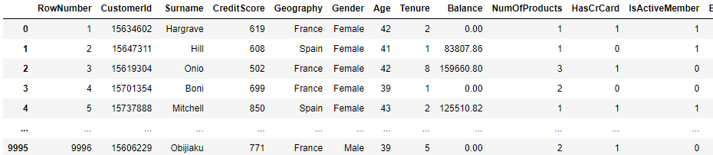
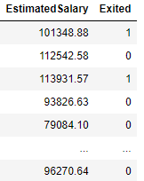
1. Data Preparation
import numpy as np
import matplotlib.pyplot as plt
import pandas as pnd
from sklearn.model_selection import train_test_split
from sklearn.preprocessing import LabelEncoder, OneHotEncoder
from sklearn.preprocessing import StandardScaler
Load Data set in a Dataframe
Visualize Data with DataFrame: head, tail, describe
Identify the type of problem
identify non-predictive features without any analysis
Extract data from the dataframe
dataset=pnd.read_csv("Churn_Modelling.csv")

Slide 6
1. Data Preparation
Load Data set in a Dataframe
Visualize Data with DataFrame: head, tail, describe
Identify the type of problem
identify non-predictive features without any analysis
Extract data from the dataframe
Binary type: Binary classification problem

Slide 7
1. Data Preparation
Load Data set in a Dataframe
Visualize Data with DataFrame: head, tail, describe
Identify the type of problem
identify non-predictive features without any analysis
Extract data from the dataframe
Non predictive features

Slide 8
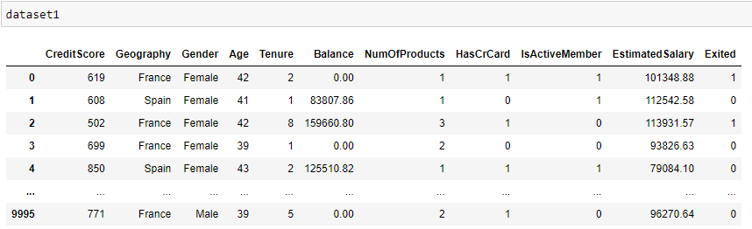
1. Data Preparation
Load Data set in a Dataframe
Visualize Data with DataFrame: head, tail, describe
Identify the type of problem
identify non-predictive features without any analysis
Extract data from the dataframe
dataset1=dataset.iloc[:,3:14]

Slide 9
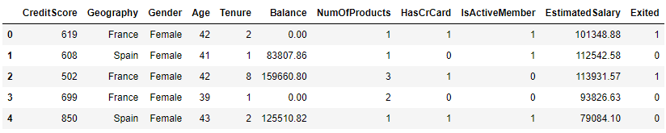
1. Data Preparation
Load Data set in a Dataframe
Visualize Data with DataFrame
Identify the type of problem
identify non-predictive features without any analysis
Extract columns, lines from a DataFrame
Identfiy features type: binary, categorical
Encode categorical variables
Encode binary variable
Encode ordinal variables
categorical
binary
continuous
discret
continuous

Slide 10
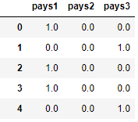
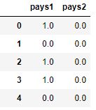
1. Data Preparation
Load Data set in a Dataframe
Visualize Data with DataFrame
Identify the type of problem
identify non-predictive features without any analysis
Extract columns, lines from a DataFrame
Identfiy features type: binary, categorical
Encode categorical variables
Encode binary variable
Encode ordinal variables
onehotencoder=OneHotEncoder()
pays=onehotencoder.fit_transform(dataset[['Geography’]])
pays=pays.toarray()
result1=pnd.DataFrame(pays,columns=['pays1','pays2','pays3’])
result2=result.drop('pays3', axis=1)
result1
result2

Slide 11
1. Data Preparation
Load Data set in a Dataframe
Visualize Data with DataFrame
Identify the type of problem
identify non-predictive features without any analysis
Extract columns, lines from a DataFrame
Identfiy features type: binary, categorical
Encode categorical variables
Encode binary variable
Encode ordinal variables
onehotencoder=OneHotEncoder()
pays=onehotencoder.fit_transform(dataset[['Geography’]])
pays=pays.toarray()
result1=pnd.DataFrame(pays,columns=['pays1','pays2','pays3’])
result2=result.drop('pays3', axis=1)
result3=dataset1.drop('Geography', axis=1)
result2

Slide 12
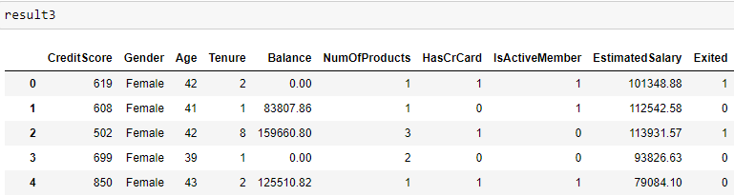
1. Data Preparation
Load Data set in a Dataframe
Visualize Data with DataFrame
Identify the type of problem
identify non-predictive features without any analysis
Extract columns, lines from a DataFrame
Identfiy features type: binary, categorical
Encode categorical variables
Encode binary variable
Encode ordinal variables
result2

Slide 13
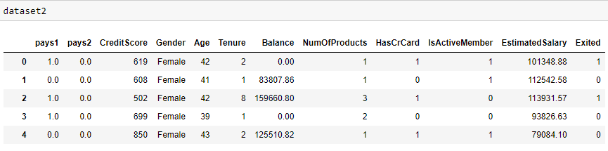
1. Data Preparation
Load Data set in a Dataframe
Visualize Data with DataFrame
Identify the type of problem
identify non-predictive features without any analysis
Extract columns, lines from a DataFrame
Identfiy features type: binary, categorical
Encode categorical variables
Encode binary variable
Encode ordinal variables
dataset2=pnd.concat([result2,result3],axis=1)

Slide 14
1. Data Preparation
Load Data set in a Dataframe
Visualize Data with DataFrame
Identify the type of problem
identify non-predictive features without any analysis
Extract columns, lines from a DataFrame
Identfiy features type: binary, categorical
Encode categorical variables
Encode binary variable
Encode ordinal variables
label_encoder=LabelEncoder()
dataset2['Gender']= label_encoder.fit_transform(dataset2['Gender'])

Slide 15
1. Data Preparation
Load Data set in a Dataframe
Visualize Data with DataFrame
Identify the type of problem
identify non-predictive features without any analysis
Extract columns, lines from a DataFrame
Identfiy features type: binary, categorical
Encode categorical variables
Encode binary variable
Encode ordinal variables
Dataset not contain an ordinal variable

Slide 16
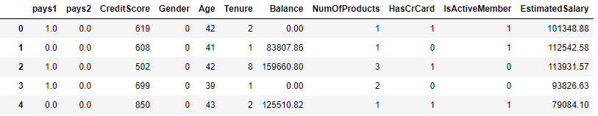

1. Data Preparation
Load Data set in a Dataframe
Visualize Data with DataFrame
Identify the type of problem
identify non-predictive features without any analysis
Extract columns, lines from a DataFrame
Identfiy features type: binary, categorical
Encode categorical variables
Encode binary variable
Encode ordinal variables
Separate features & target
Split data
Rescale Data
X=dataset2.iloc[:,:11]
y=dataset.iloc[:,11]

Slide 17
1. Data Preparation
Load Data set in a Dataframe
Visualize Data with DataFrame
Identify the type of problem
identify non-predictive features without any analysis
Extract columns, lines from a DataFrame
Identfiy features type: binary, categorical
Encode categorical variables
Encode binary variable
Encode ordinal variables
Separate features & target
Split data
Rescale Data
X_train,X_test,y_train,y_test=train_test_split(X,y,test_size=0.25)

Slide 18
1. Data Preparation
Load Data set in a Dataframe
Visualize Data with DataFrame
Identify the type of problem
identify non-predictive features without any analysis
Extract columns, lines from a DataFrame
Identfiy features type: binary, categorical
Encode categorical variables
Encode binary variable
Encode ordinal variables
Separate features & target
Split data
Rescale Data
X_train,X_test,y_train,y_test=train_test_split(X,y,test_size=0.25)

Slide 19
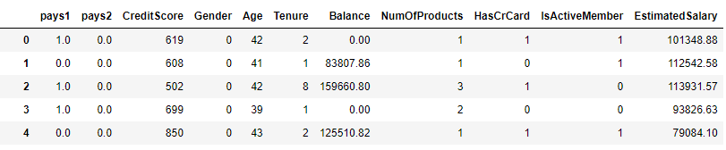
1. Data Preparation
Load Data set in a Dataframe
Visualize Data with DataFrame
Identify the type of problem
identify non-predictive features without any analysis
Extract columns, lines from a DataFrame
Identfiy features type: binary, categorical
Encode categorical variables
Encode binary variable
Encode ordinal variables
Separate features & target
Split data
Rescale Data
sc=StandardScaler()
X_train[:,[2,4,5,6,7,10]]=sc.fit_transform(X_train[:,[2,4,5,6,7,10]])
X_test[:,[2,4,5,6,7,10]]=sc.transform(X_test[:,[2,4,5,6,7,10]])

Slide 20
2. Model
Choose the technique (Linear Regression, Neural Netwrok, SVR,…)
choose an architecture
Create a neural network according to the architecture
Initialize the model
create input layer and hidden layers
Create output layer
Compile
optimizer
Loss
metrics

Slide 21
3. Prediction

Slide 22
4. Evaluation

Slide 23
5. Improve Performance

